Slide 1

The Link Layer
Computer Networks
Introduction to the Link Layer
Error-detection and -correction Techniques
Multiple Access Links and Protocols
Switched Local Area Networks
Link Virtualization: a Network as a Link Layer
Data Center Networking
Retrospective: A Day in the Life of a Web Page Request

Slide 2
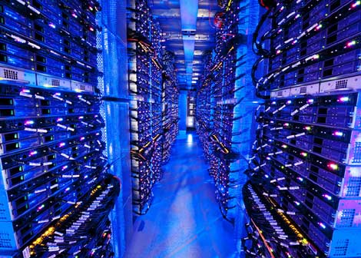
Datacenter networks
10’s to 100’s of thousands of hosts, often closely coupled, in close proximity:
e-business (e.g. Amazon)
content-servers (e.g., YouTube, Akamai, Apple, Microsoft)
search engines, data mining (e.g., Google)
challenges:
multiple applications, each serving massive numbers of clients
reliability
managing/balancing load, avoiding processing, networking, data bottlenecks
Inside a 40-ft Microsoft container, Chicago data center

Slide 3
Datacenter networks: network elements
Border routers
connections outside datacenter
Tier-1 switches
connecting to ~16 T-2s below
Tier-2 switches
connecting to ~16 TORs below
…
…
…
…
Top of Rack (TOR) switch
one per rack
40-100Gbps Ethernet to blades
…
…
…
…
Server racks
20- 40 server blades: hosts

Slide 4
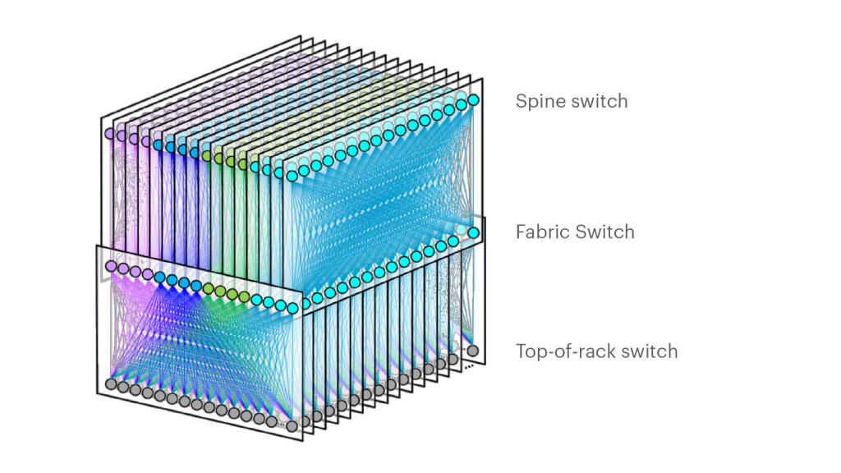
Datacenter networks: network elements
Facebook F16 data center network topology:
https://engineering.fb.com/data-center-engineering/f16-minipack/ (posted 3/2019)

Slide 5
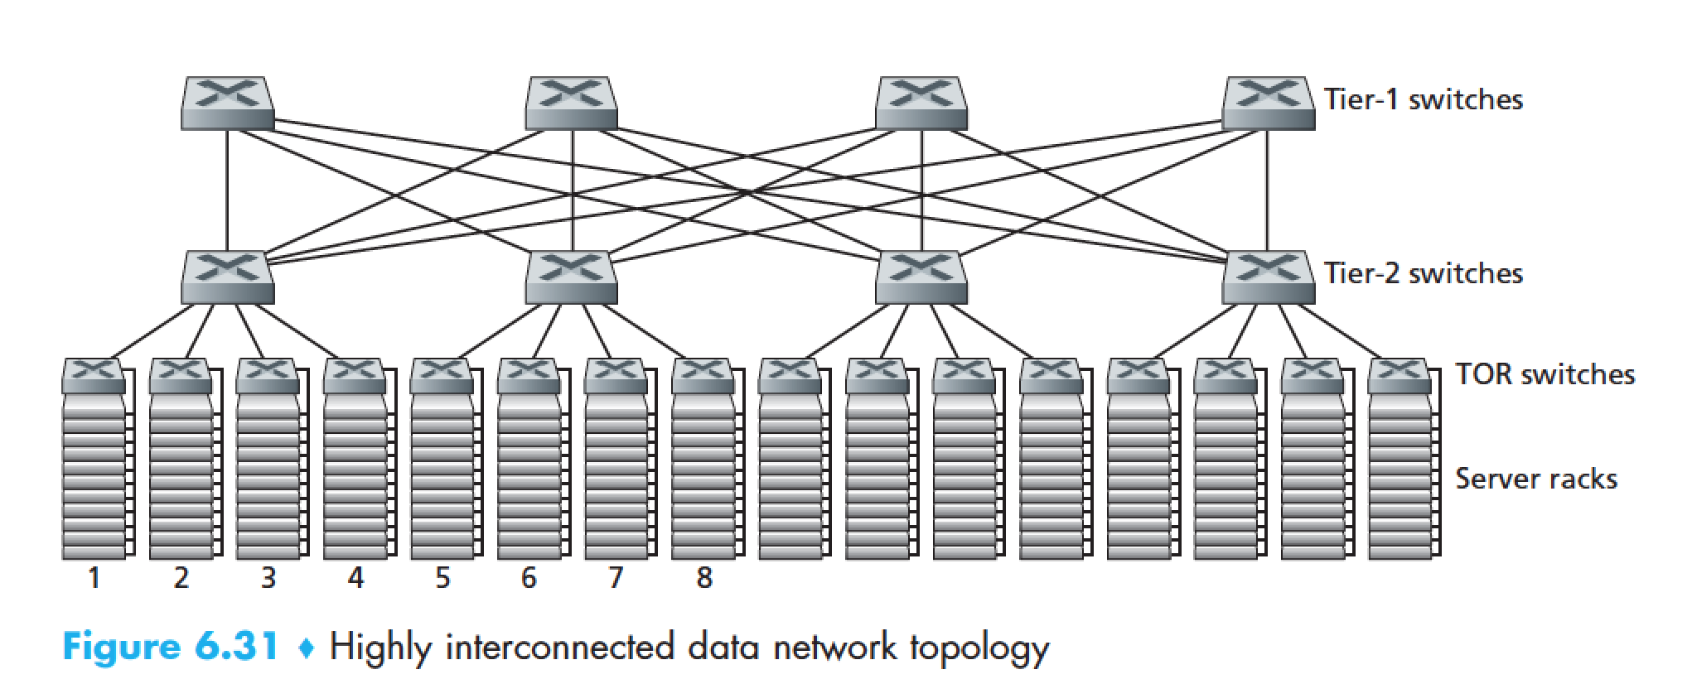
Datacenter networks: multipath
rich interconnection among switches, racks:
increased throughput between racks (multiple routing paths possible)
increased reliability via redundancy
9
10
11
12
13
14
15
16
two disjoint paths highlighted between racks 1 and 11

Slide 6
Datacenter networks: application-layer routing
Internet
load balancer: application-layer routing
receives external client requests
directs workload within data center
Load
balancer
…
…
…
…
returns results to external client (hiding data center internals from client)
…
…
…
…

